Slide 1



Netflix Originals Recommendations

Slide 2


Presentation Overview
1
Problem
2
Process and Issues
3
Solution and Final Data
4
Room for Improvement

Slide 3
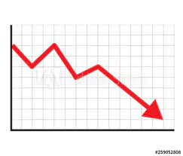


Problem
Netflix, which once unequivocally dominated the SVOD streaming industry, is now plateauing in subscriber growth.
This is most likely due to the lack of major new releases, inactive accounts, and growth of competitors
Our research will help Netflix determine which type of original content performs best in terms of ratings and social media word of mouth that the company should invest in.
We will be focusing specifically on Netflix Originals, both films and tv shows
Notes:
Cut this down

Slide 4
Process Overview
Get all information on Netflix Originals film and tv shows (e.g. Titles, Unique IDs, Ratings, #of reviews, genre, etc.)
Get all reviews and conduct sentimental analysis, organize all data
Plot graphs, analyze the observation & result
Build flask application that allow user to display result from different endpoints

Slide 5
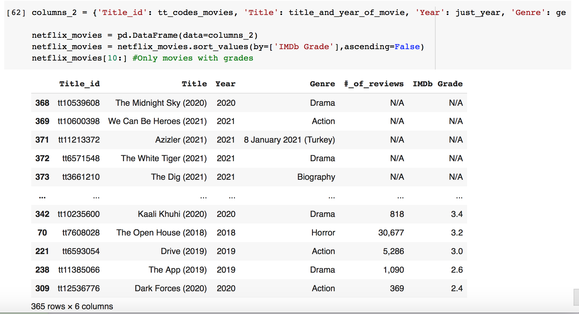
Process: Web-Scraping
Web-scraping using .json to get individual tv/movie link & tt-code
BeautifulSoup to get Title, Title ID, # of reviews, IMDb grade
Regex to get year released
Used pandas to create 2 data-frames from highest to lowest IMDb grade

Slide 6

Uncertainties
Categories (title, IMDb grade, year, number of reviews, and genre) are subjectively judged, so it is not clear which is the most important factor to consider when choosing shows/movies.
Some shows might be either a one-season reboot, a mini-series, or were cancelled after one season, or a continuing show
There is always a possibility that the listings will have been updated, so formatting will be off.
1
2

Slide 7
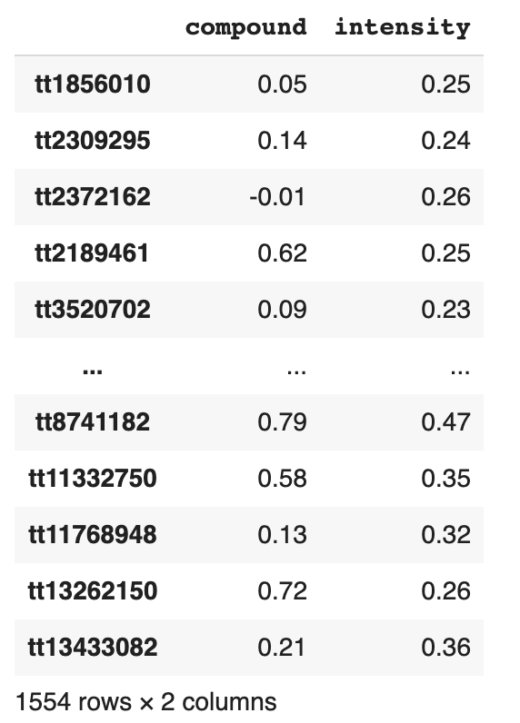
Process: Sentiment Analysis
VADER Sentiment Analysis Package
SentimentIntensityAnalyzer to get a score for each review and loop through all reviews, e.g. {'compound': -0.969, 'neg': 0.17, 'neu': 0.695, 'pos': 0.136}
Get the compound score out and calculate the mean as the sentiment score
Add up the absolute score of negative and positive to get a intensity score

Slide 8
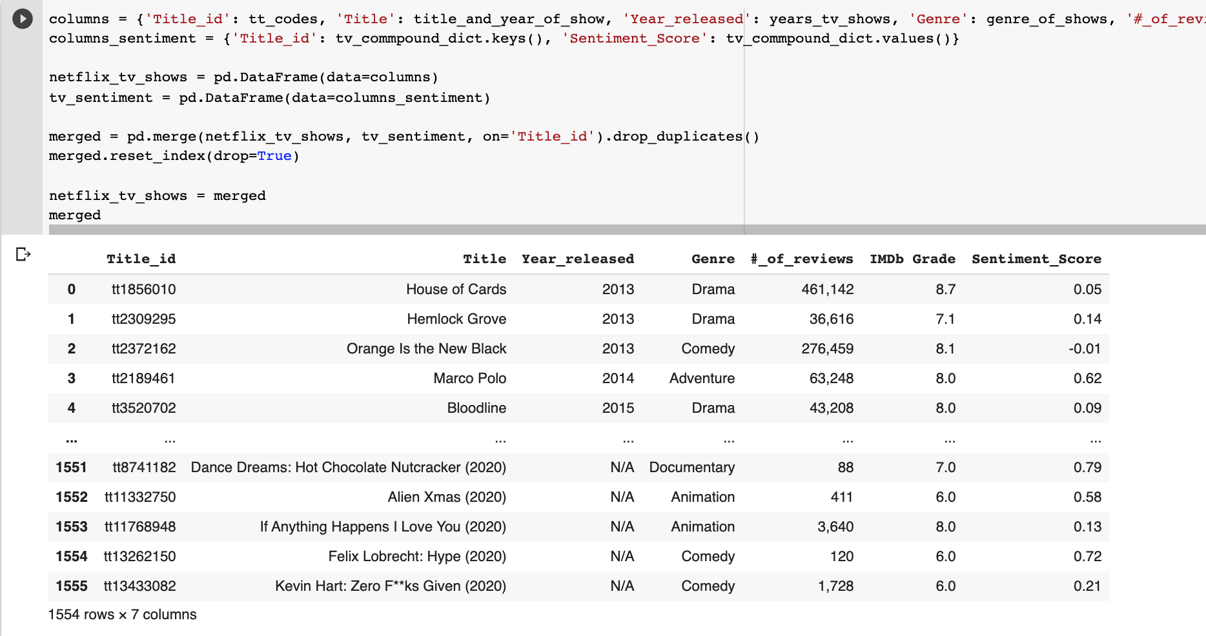
Final Data
1
2

Slide 9
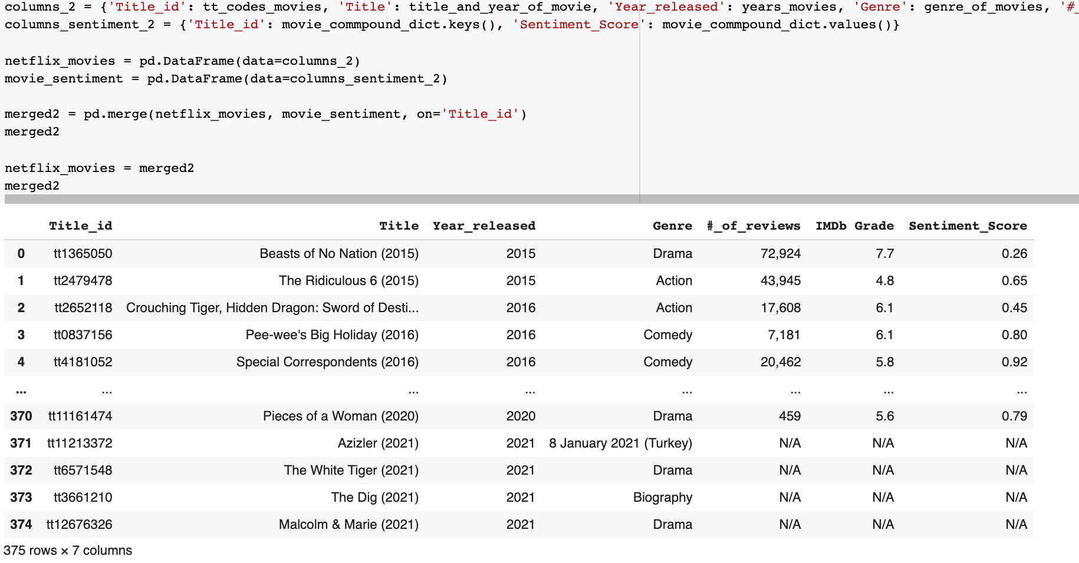
Final Data
1
2

Slide 10
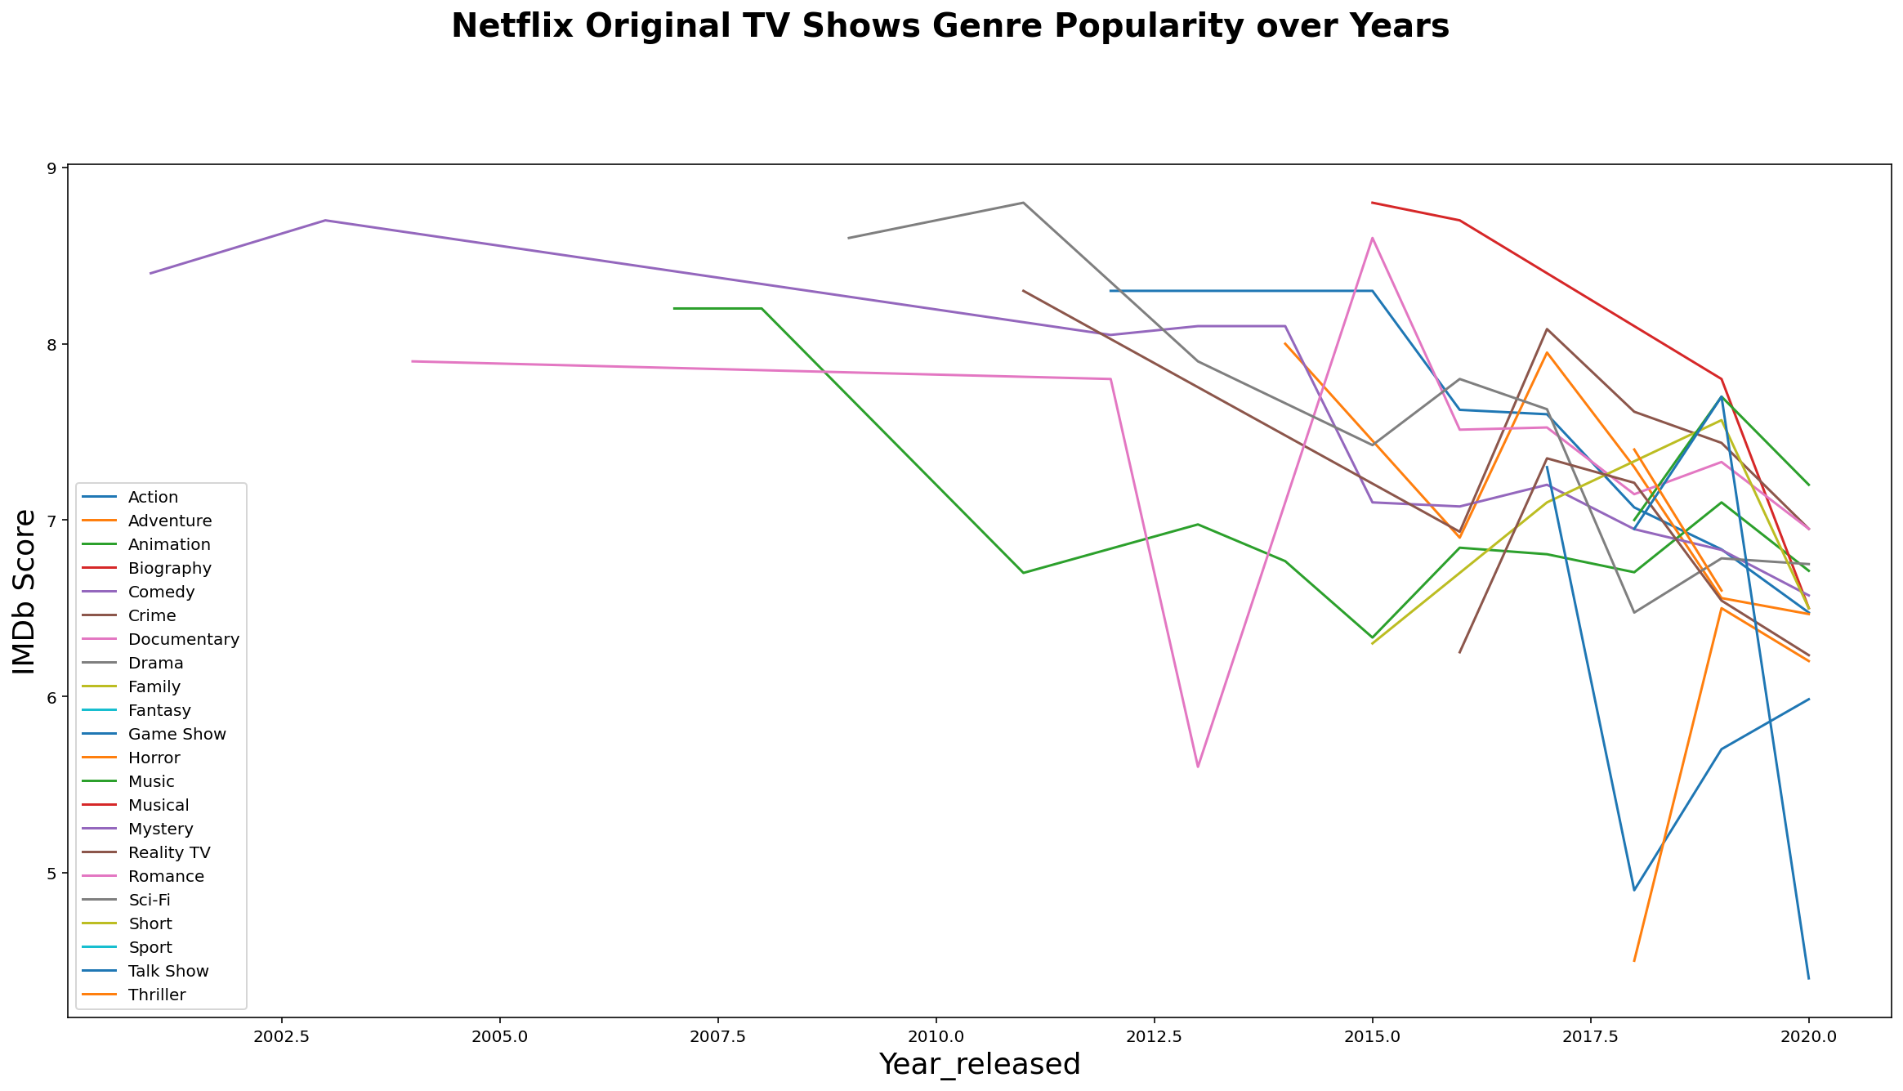
TV Graph
1
2

Slide 11
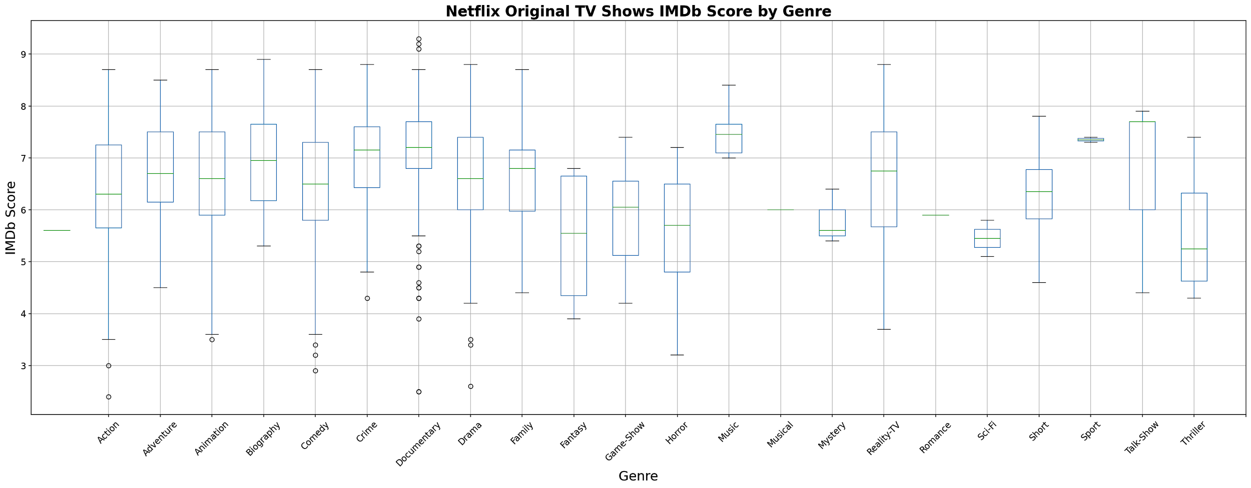
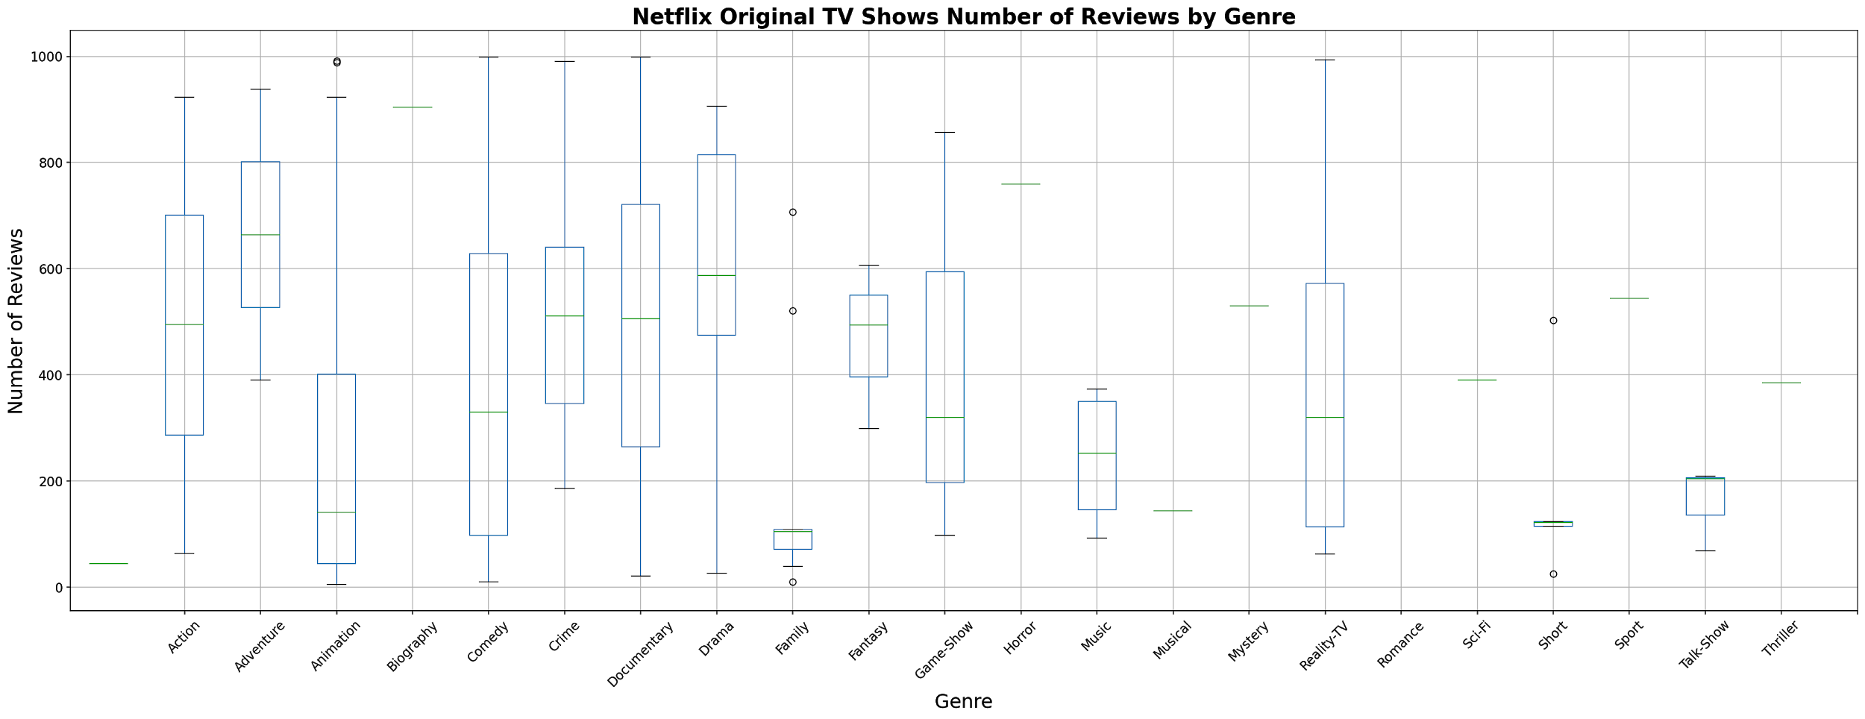
TV Shows
KEY INSIGHTS:
Documentary series are highly varied in rating score and number of reviews even though the average rating is high
Music TV shows have few people rating but perform very well
Adventure and Crime shows generally have consistently good ratings with high review rates
1
2

Slide 12
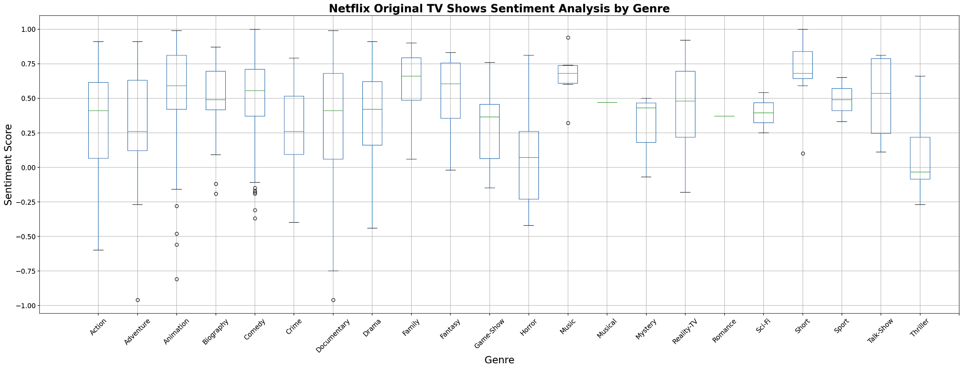
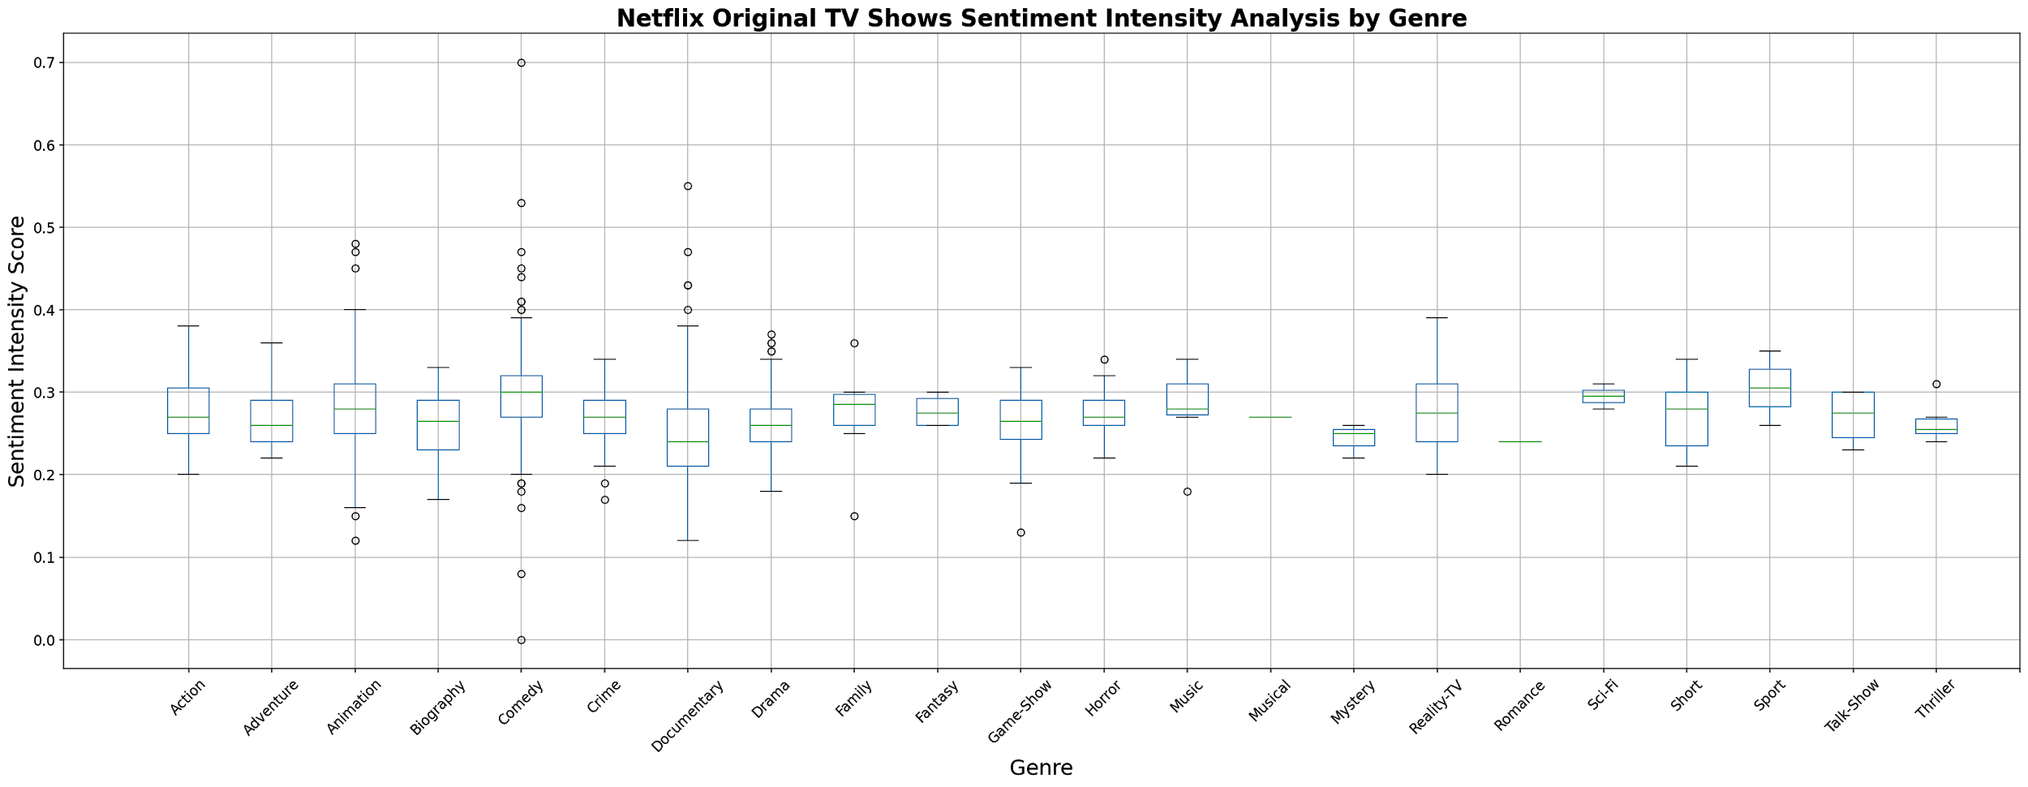
TV Shows
KEY INSIGHTS:
Documentary series again show a wide spectrum of emotions — people either respond very positively or very negatively
Comedies are also polarizing
Sports and Music shows have positive response but few reviews
Family and Animation are generally positive
1
2

Slide 13
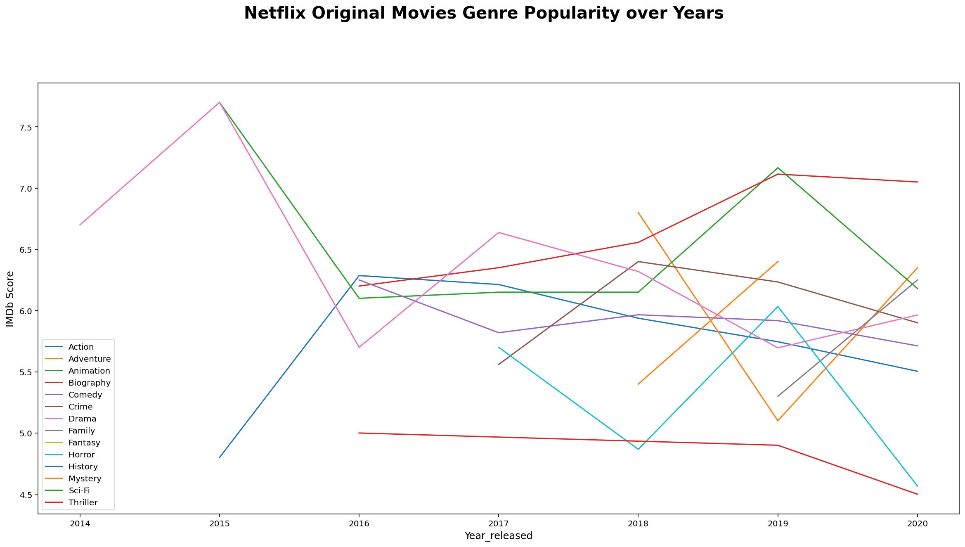
Movie Graph
1
2

Slide 14
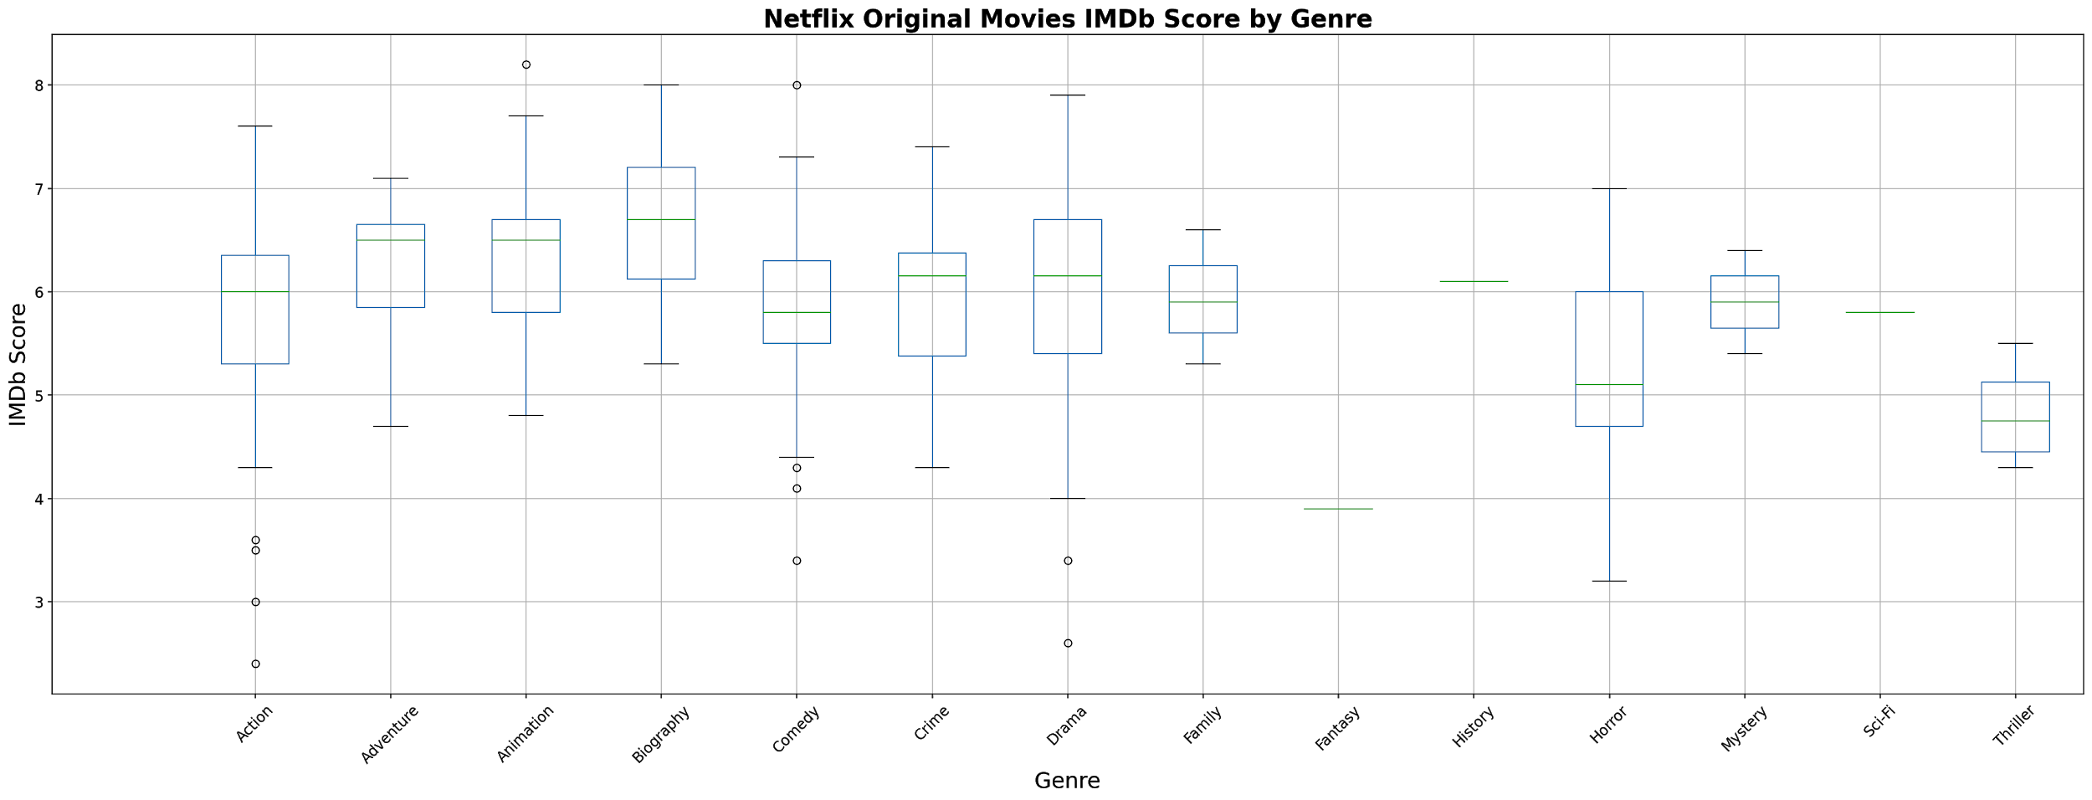
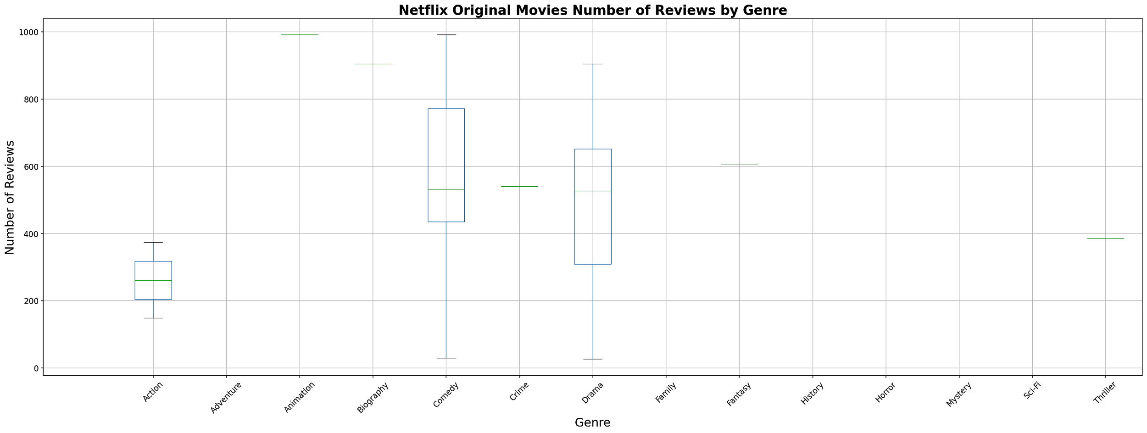
Movies
KEY INSIGHTS:
Biopics, Adventure, and Animation movies score the highest
1
2

Slide 15
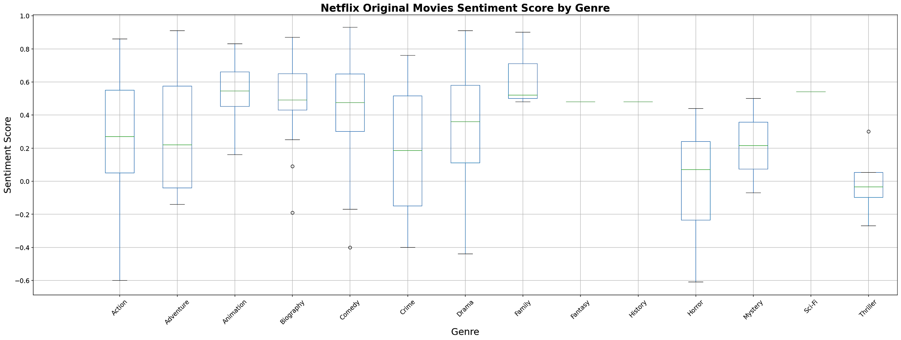
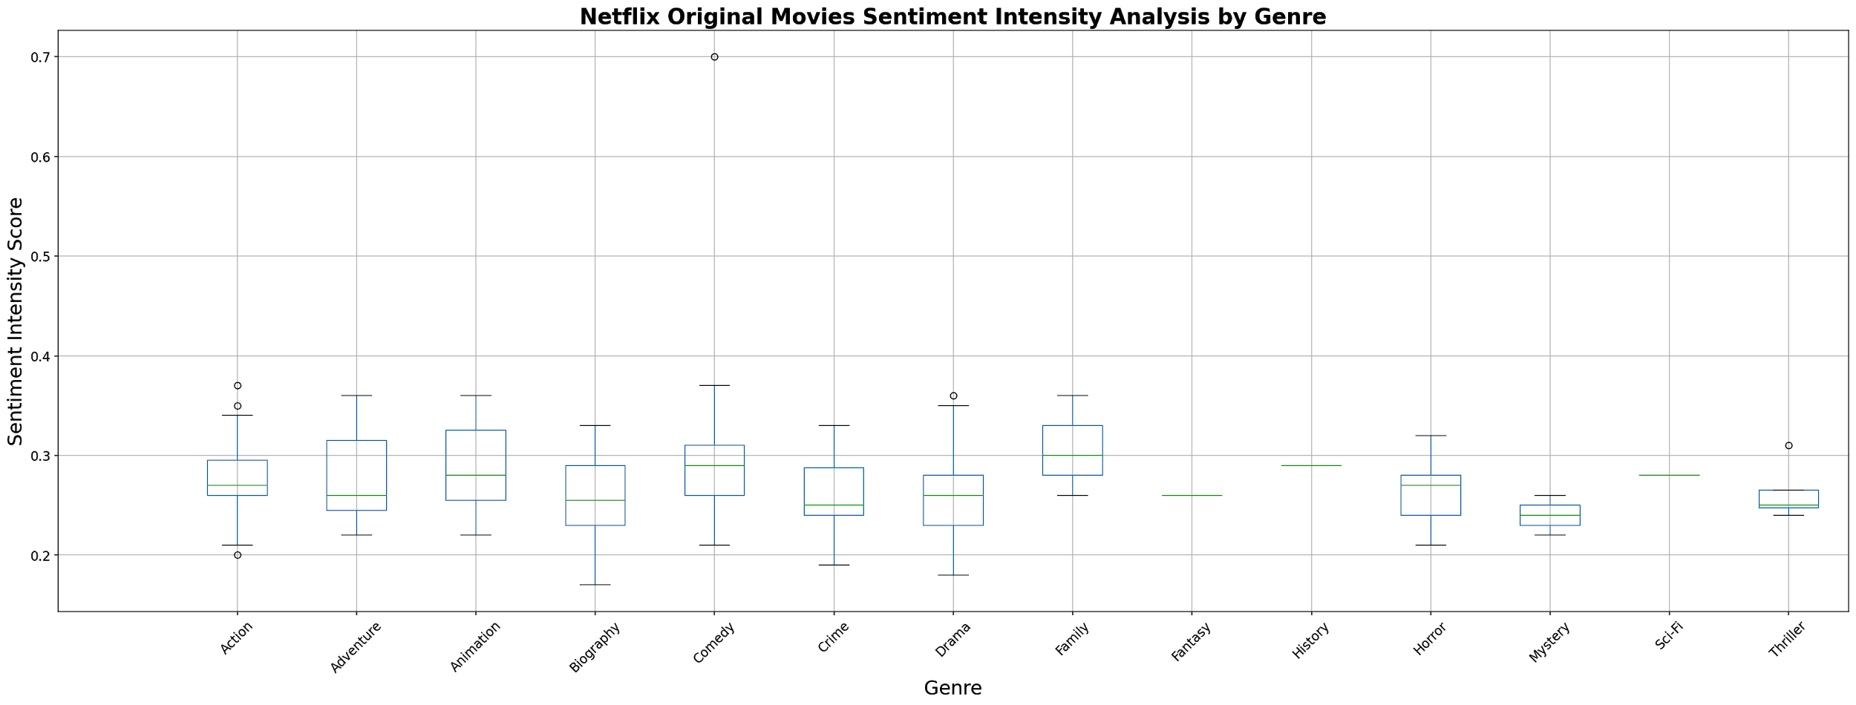
Movies
KEY INSIGHTS:
Significantly weaker opinions than with Netflix TV
Action is the most varied — some movies have a 0.6 compounded sentiment score, some have a 0.8 compound score
Horror and Thrillers have generally negative reviews
1
2

Slide 16

User Interaction
Users can choose different endpoints in a flask to obtain data from IMDB (number of reviews, IMDB score, genre, etc.)
Different endpoints for compare data on ratings with different genres, movies or TV shows, or sentiment analysis.
This could aid Netflix in making management decisions on where to allocate their spendings
Different Endpoints are
/tv
/movie
/tvgraphs
/moviegraphs

Slide 17
Issues & Room For Improvement
One time we tried to web scrape titles of the shows and movies, and the output had Chinese characters.
Took a long time to run code so we created pickles
Matplotlib and JSON did not work in Flask
Don’t set the values (title, genre, number of reviews, IMDb grades) as proxy variables
Collect the movie runtime, movie ratings (ex: TV-MA, PG, R), and list of actors/actresses)
Request to use the Twitter API, so to better figure out sentiment analysis of tweets.
1
2

Slide 18
Our Recommendation for Netflix
Based on our findings, we suggest that Netflix invest more money in:
Exceptional Documentary, Crime, and Adventure series: high ratings and emotional investment
Emotional Family and Animation series and movies: high emotional investment
Limitation: Need to compare to Netflix-owned subscriber data
1
2

Slide 19
Q&A

